Slide 1


Multi-Omics Analysis on AML Using MOFA
FCI – Assiut University | 2024

Slide 2

Agenda
1
Introduction
7
Applying MOFA on AML
2
Purpose of multi-omics
8
Visualization of features weights
3
Types of integration methods
9
Knowing our variances
4
Multi-Omics Factor Analysis
10
Some other visualizations
5
Why we used MOFA
11
Conclusion
6
Acute myeloid leukemia
12
Future work
FCI – Assiut University | 2024

Slide 3
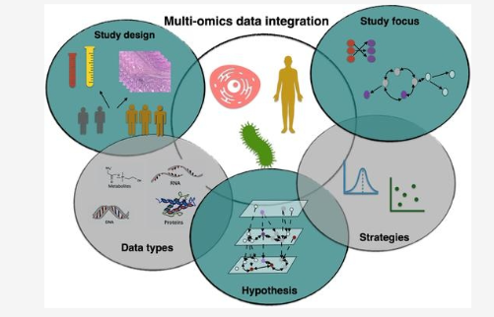
Concept of Multi-omics data integration
INTRODUCTION
Multi-omics combines data from multiple platforms for comprehensive and in-depth profiling of biological processes. A critical parameter for maximizing the applicability of multi-omics profiling is data integration, which encompasses bioinformatic tools, pipelines, and databases. Data integration of multi-omics strategies promotes the development of biomarkers, definition of disease phenotypes, characterization of virulence factors, and discovery of druggable targets among other potential outcome.
FCI – Assiut University | 2024

Slide 4

Purpose of multi-omics
Capturing the heterogeneity of data in one module or in one group or more.
Identifying missing data , unknown data and outliers.
Integrate different modules(different types of data).
Identifying sample subgroups.
FCI – Assiut University | 2024

Slide 5
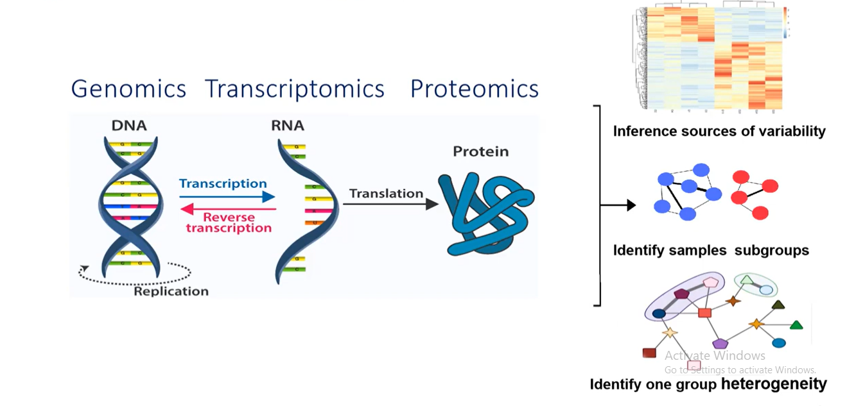
Purpose of multi-omics
FCI – Assiut University | 2024

Slide 6
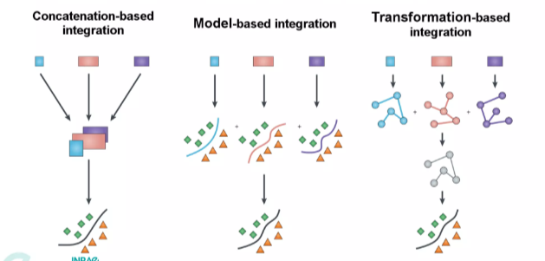
Types of integration methods
FCI – Assiut University | 2024

Slide 7
Multi-Omics Factor Analysis
FCI – Assiut University | 2024

Slide 8
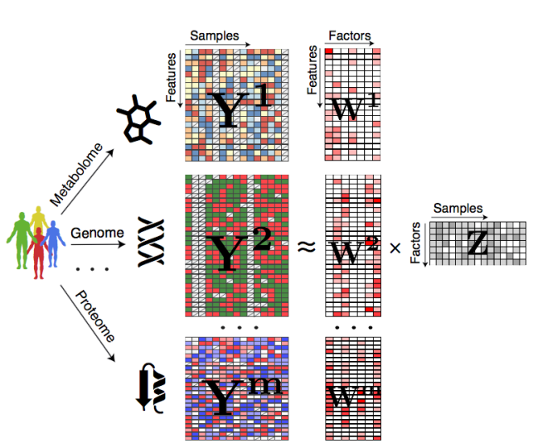
Multi-Omics Factor Analysis
Model overview of MOFA
MOFA is a model that combines different types of biological data to find common patterns. Think of it like an advanced version of principal component analysis for multiple data sets. It identifies key factors that explain variations in various data types, helping to understand cellular states or disease groups.
FCI – Assiut University | 2024
Fig 1: (a)

Slide 9
Why we used MOFA
FCI – Assiut University | 2024

Slide 10

Why we used MOFA
In general , We used MOFA to analyse a disease (Acute Myeloid Leukemia) to detect the status of each sample (sick or not sick).
Contribution of MOFA :
MOFA contributes to benchmark our results to make sure of the
downstream analysis of data .
Comprehensive understanding of human complex diseases requires the analysis of multi-omics data reciprocally with clinical information.
Based on the analysis, useful insights into the cellular functions are derived.
The integration helps to understand the interplay of the biomolecules and in the assessment of the information from the omics data.
Further, it improves prognostic and predictive accuracies hence better treatment and prevention of the diseases
FCI – Assiut University | 2024

Slide 11
Why we used MOFA
MOFA (Multi-Omics Factor Analysis) is a tool specifically designed for integrating multiple types of omics data, such as genomics, transcriptomics, proteomics, and metabolomics. It has several advantages over other tools:
Integration: MOFA combines diverse omics datasets into a single model, capturing shared and distinct variation across datasets
Flexibility: MOFA can handle different data sizes and handle missing values, making it suitable for various multi-omics experiments.
Dimensionality reduction: MOFA reduces the dimensionality of integrated data to decrease the attributes of the data , can greatly enhance our understanding of biological systems when effectively integrated and identifying key factors that explain the variation across datasets.
FCI – Assiut University | 2024

Slide 12
Why we used MOFA
Visualization: MOFA provides interactive visualization tools to explore and interpret integrated data, helping identify patterns and relationships between datasets.
Statistical modeling: MOFA incorporates statistical modeling for hypothesis testing and assessing the significance of patterns, enabling the discovery of biomarkers or predictive models.
User-friendly: MOFA offers a user-friendly interface with tutorials, making it accessible to researchers with different computational expertise.
FCI – Assiut University | 2024

Slide 13
Acute myeloid leukemia
Acute myelogenous leukemia (AML) is a cancer of the blood and bone marrow — the spongy tissue inside bones where blood cells are made. The word "acute" in acute myelogenous leukemia denotes the disease's rapid progression. It's called myelogenous (my-uh-LOHJ-uh-nus) leukemia because it affects a group of white blood cells called the myeloid cells.
we applied MOFA to a cohort of 200 patient samples of Acute Myeloid Leukemia (AML) that were profiled for miRNA, RNA-seq, and DNA methylation.
FCI – Assiut University | 2024

Slide 14
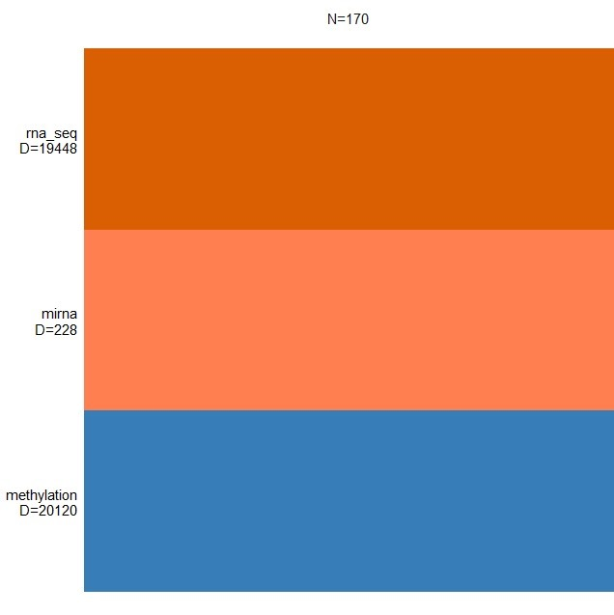
Applying MOFA on AML
We got the data of AML samples from TCGA (Linked omics).
We applied MOFA on this data by coding in R language and used DNA methylation, RNA-seq and micro RNA as views .
In AML ,MOFA discovers a low dimensional space spanned by known clinical markers and underappreciated axes of variation such as oxidative stress.
Researchers used MOFA to study Acute Myeloid Leukemia (AML) by combining clinical data like age and gender with genetic information. MOFA effectively handled different types of data, identifying shared and specific factors across them. It outperformed other methods in consistent factor identification, making it reliable for complex analyses. This integrated approach with diverse datasets ensured reliable comparisons and robust findings in the study of AML.
Omics types (data types)
Fig 2
FCI – Assiut University | 2024

Slide 15
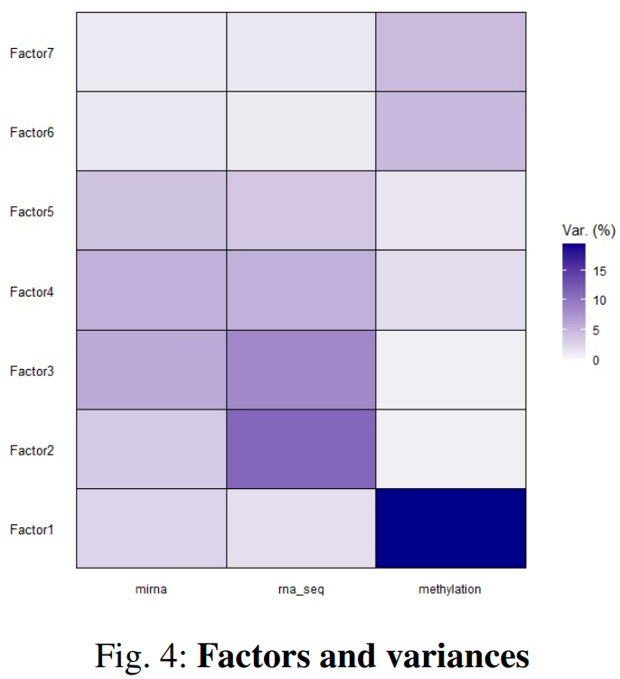
Knowing our variances
Factors and variances
Here, we have broken down variances by omics type factor.
We discovered that Factor 1 exhibits significant variation in DNA methylation modalities.
Factor 2's RNA-Seq variance is moderate(medium).
Factor 3 in RNA-seq and mirna are very similar. Because the variations of other components are expressed worse, we disregarded them.
Fig 4
FCI – Assiut University | 2024

Slide 16
Visualizations after applying MOFA on AML
FCI – Assiut University | 2024

Slide 17
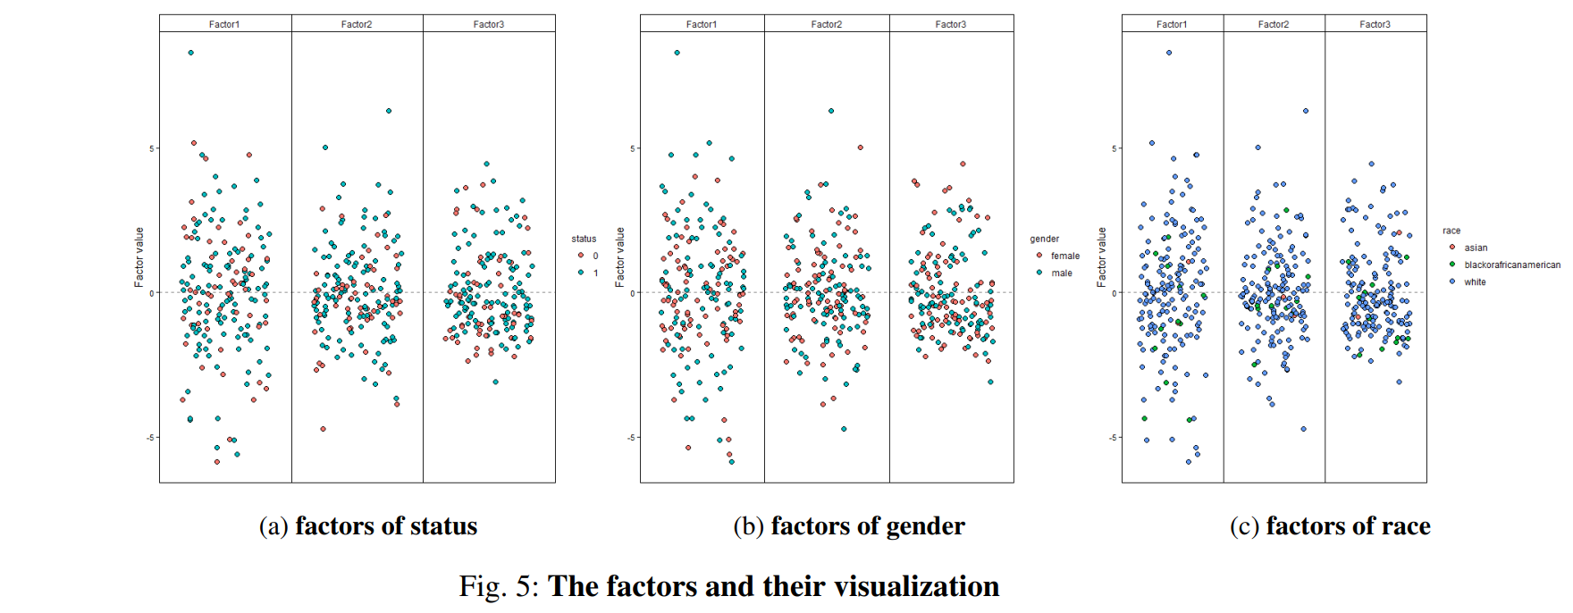
Visualization of factors
Figures 5a, 5b, and 5c effectively illustrate the distribution of clinical samples based on status, gender, and race, respectively, using color-coded dots to represent different groups.
FCI – Assiut University | 2024

Slide 18
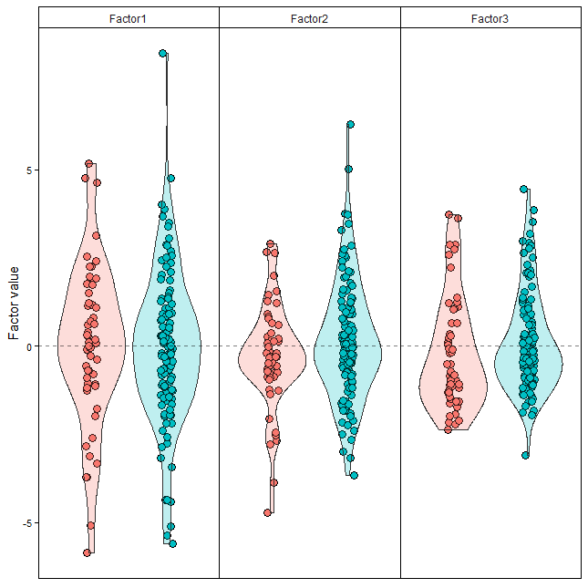
Visualization of factors cont.
These figures appear that the hidden layers in the data are represented by factors, and correlations between these factors and specific columns in the clinical data are being analyzed. Let's break down the paragraph to explain it further:
In fig(a), the correlation analysis is focused on the "status" column in the clinical data. The factors, namely factor1, factor2, and factor3, are associated with this column. The correlation values range between -5 and 5, indicating the strength and direction of the relationship between the factors and the status column.
Fig 6: (a)
FCI – Assiut University | 2024

Slide 19
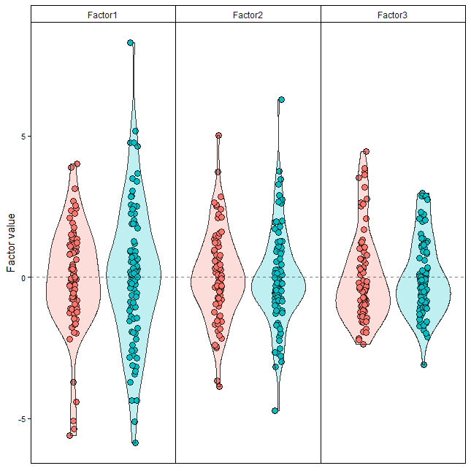
Visualization of factors cont.
Moving on to fig(b), the correlation analysis is performed on the "gender" column. Three factors are considered in this case, although the specific factor names are not mentioned. The purpose is to explore the relationship between these factors and the gender column, providing insights into the hidden layers within the data.
Fig 6: (b)
FCI – Assiut University | 2024

Slide 20
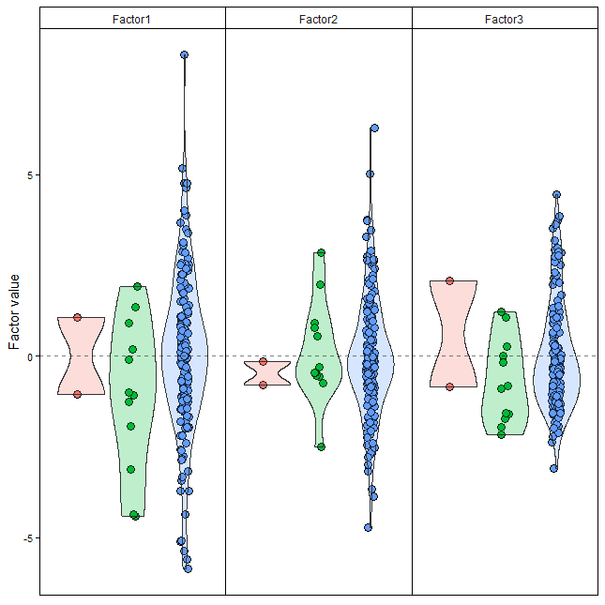
Visualization of factors cont.
Similarly, fig(c) investigates the correlation between the "race" column and three factors. Again, the factor names are not specified, but the analysis aims to uncover the underlying structures or patterns within the data related to race.
Fig 6: (c)
FCI – Assiut University | 2024

Slide 21
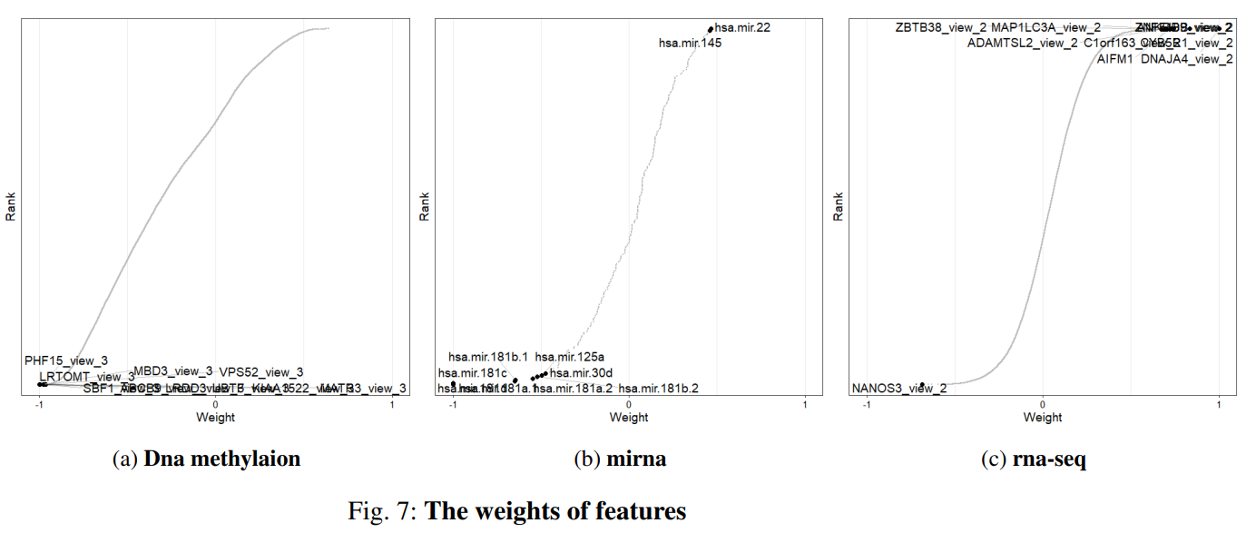
Visualization of features
weights
the weights provide a score for how strong each feature relates factor 1. Methylation with no association with the factor 1
FCI – Assiut University | 2024

Slide 22
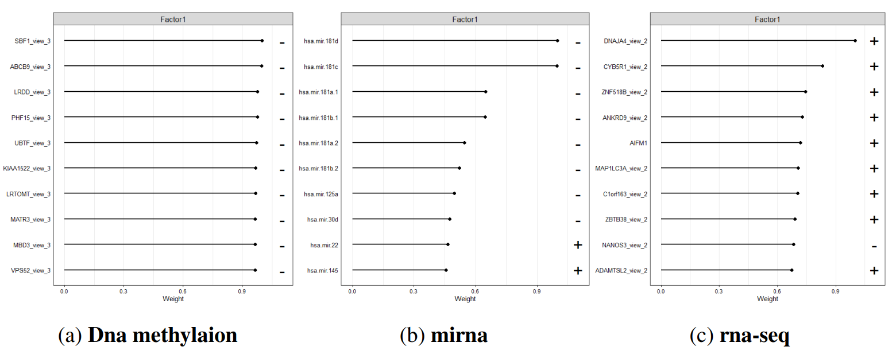
Visualization of features
weights cont.
Fig 8: Top weights
FCI – Assiut University | 2024

Slide 23
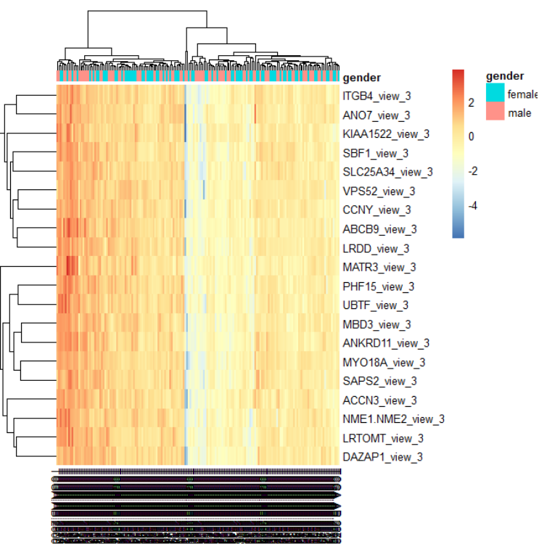
Visualization of heatmap
Methylation Heatmap:
Exploring methylation patterns across genders for selected genes.
Heatmap depicting the methylation levels for specific genes and their association with gender.
Fig 9: (a)
FCI – Assiut University | 2024

Slide 24
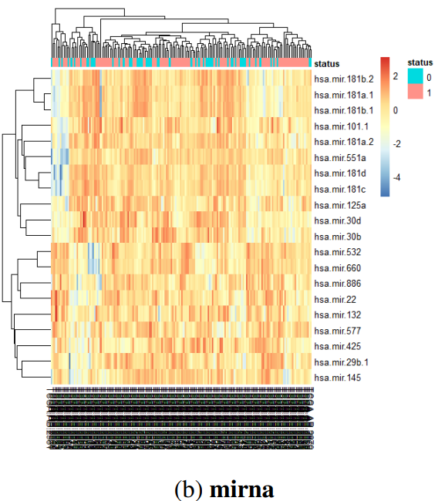
Visualization of heatmap cont.
miRNA Heatmap:
Examining miRNA expression patterns based on status and gene names.
Heatmap illustrating the miRNA profiles related to different statuses for the specified genes.
Fig 9: (b)
FCI – Assiut University | 2024

Slide 25
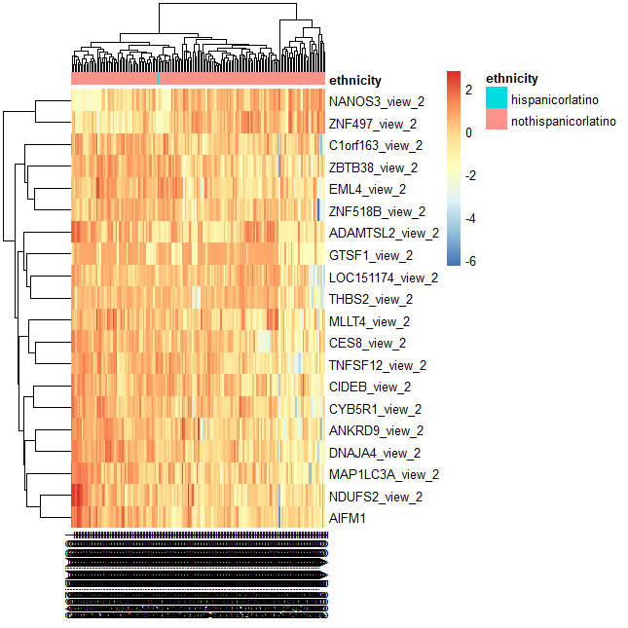
Visualization of heatmap cont.
RNA-seq Heatmap:
Investigating RNA-seq data across ethnicities for the chosen set of genes.
Heatmap showcasing the gene expression variations in RNA-seq data based on ethnicity.
Fig 9: (c)
FCI – Assiut University | 2024

Slide 26
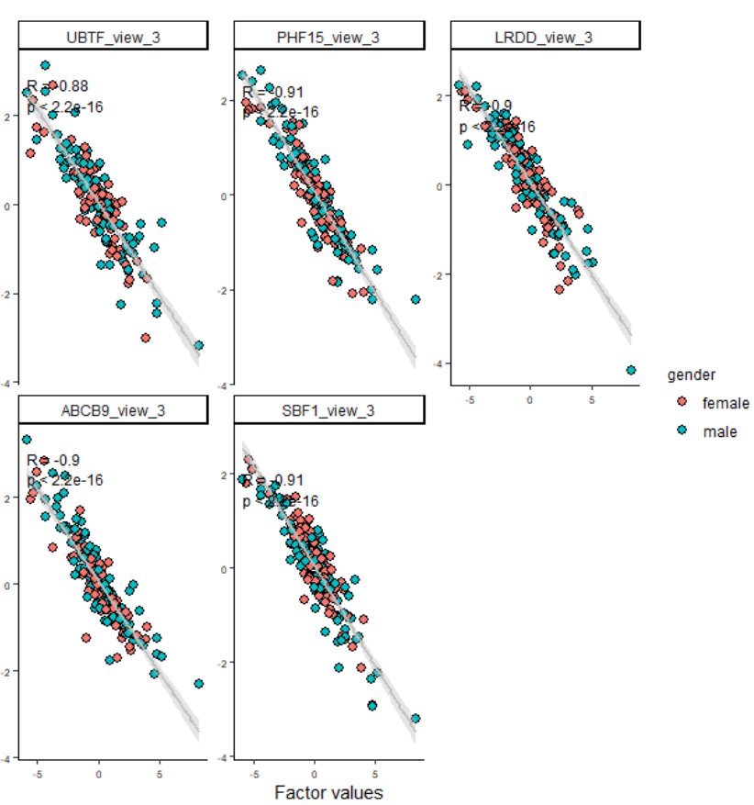
Visualization of Scatter plots
Methylation Scatter plot:
Scatter plot representing the relationship between methylation levels, gender, and selected genes.
Visualizing the scatter plot of methylation data, highlighting gender-specific patterns for certain genes.
Fig 10: (a)
FCI – Assiut University | 2024

Slide 27
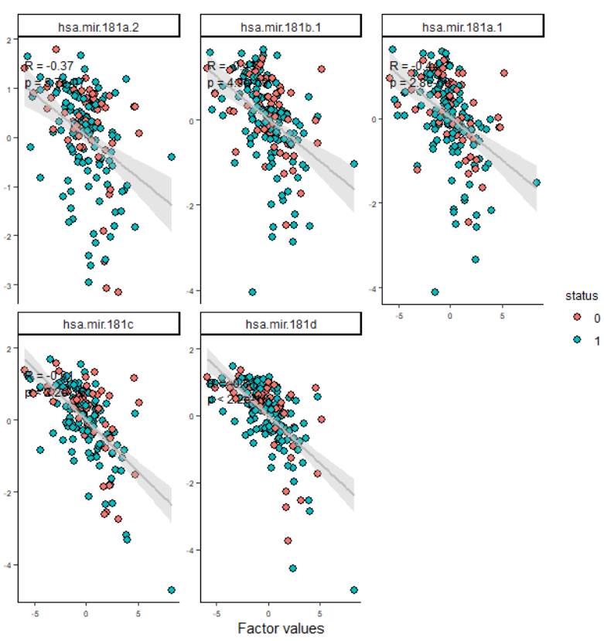
Visualization of Scatter plots cont.
miRNA Scatter plot:
Scatter plot revealing the connection between miRNA expression, status, and gene names.
Analyzing the scatter plot of miRNA data, emphasizing the correlation with different statuses for specific genes.
Fig 10: (b)
FCI – Assiut University | 2024

Slide 28
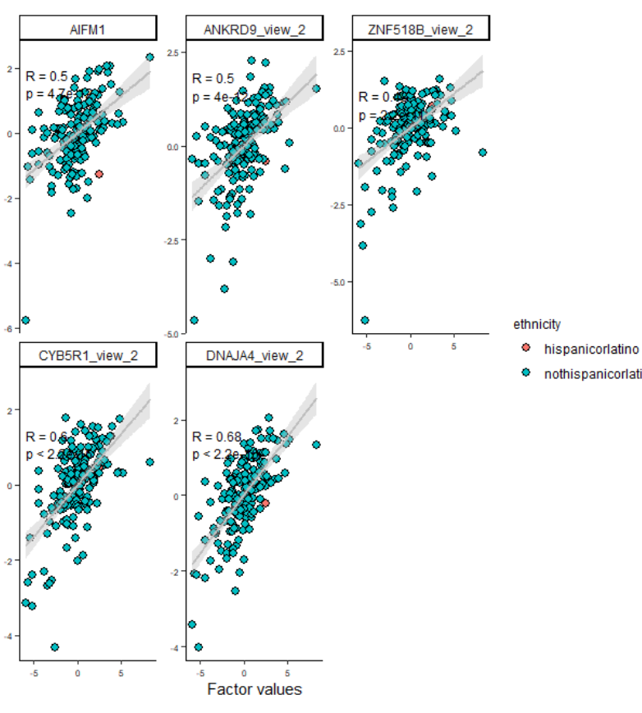
Visualization of Scatter plots cont.
RNA-seq Scatter plot:
Scatter plot illustrating RNA-seq data, showcasing the interplay between ethnicity and gene expression.
Exploring the scatter plot of RNA-seq data, emphasizing the impact of ethnicity on the expression of selected genes.
Fig 10: (c)
FCI – Assiut University | 2024

Slide 29
Conclusion
Multi-omics studies enrich our grasp of biological processes across diverse molecular layers. Nevertheless, the challenge lies in effectively integrating heterogeneous datasets from these studies. Addressing this gap, we present Multi-Omics Factor Analysis (MOFA), a computational tool unveiling primary sources of variation in multi-omics datasets.
MOFA deploys statistical modeling to infer hidden factors capturing both biological and technical variability. It discerns shared heterogeneity across modalities and specificity to individual data types. Learning these factors empowers downstream analyses, including subgroup identification, missing data imputation, and outlier detection.
In our AML patient study, MOFA was applied to a cohort of 200 samples, profiling miRNA, RNA-seq, and DNA methylation.
Link of our code :https://drive.google.com/drive/u/0/folders/
1odUuYqc_rV7ACmGFUI4Ar3OeVEvDqyfx
FCI – Assiut University | 2024

Slide 30


Integrating Mutation Dataset
Since the mutation dataset includes a distinct marker that makes our data easier to understand, we will add it to the existing dataset.
Future work
Creating Network
For every omic data that we use, a network will be created.
FCI – Assiut University | 2024

Slide 31
Thank you!
Presented By:
Abdal-Aziz Al-Sayed Mohamed
Mohamed Hossam Gafaar
Eman Usama Hosni
Ezz El-Deen Amer Ali
Sohila Noaman Mahmoud
Nader Nagah Mohamed
FCI – Assiut University | 2024

